Slide 1

ROBOTICS COURSE – AUTONOMOUS CAR PROJECT
STEM
Notes:
Today we will be completing the BRONZE crest award

Slide 2
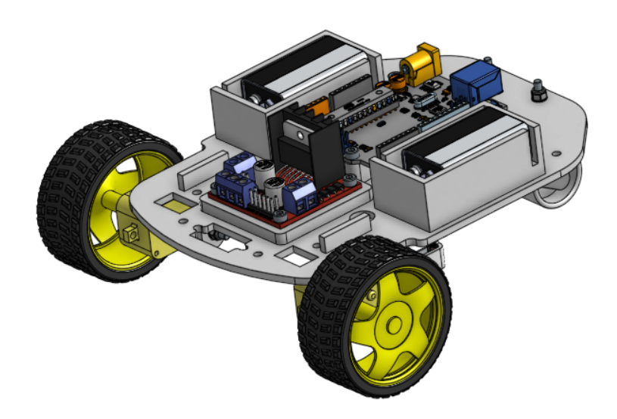
ROBOTICS COURSE – AUTONOMOUS CAR PROJECT
Motivation
Skills
CREST
Directing Staff
H&S

Slide 3
ROBOTICS COURSE – AUTONOMOUS CAR PROJECT
Day 1 | Day 2
Introduction to Arduino Programming | CREST Introduction
DC Motors | Planning your Project
Mechanical Build | Project Work
Electrical Build | Testing
Motor Programming | Team Presentations
Ultrasonic Sensor Programming
Autonomous Car Testing

Slide 4



Slide 5
STEM Icebreaker
Each time a question comes up, write your answer down on your whiteboard.
You will have 30s per slide
Still participate after you have been knocked out – you just wont be involved in the competition

Slide 6

90% Question

Slide 7
Question 1
If a motor needs 4J of energy to operate, and it has an efficiency of 80%, how much energy is required? (J – Joules, the unit of energy)

Slide 8
Answer
5J

Slide 9

75% Question

Slide 10
Question 2
Which gas makes up the majority of our atmosphere?

Slide 11
Answer
Nitrogen

Slide 12
50% Question

Slide 13
Question 3
Bob runs at 5mph for 2 hours. Dave runs at 8mph for 1.5hours. Who travels further and by what distance?

Slide 14
Answer
Dave, 2 miles more

Slide 15
30% Question

Slide 16
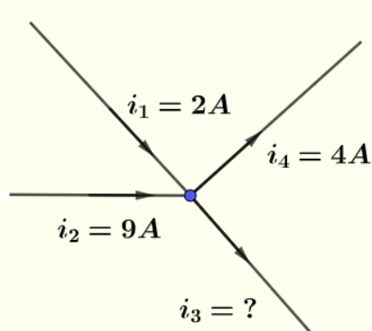
Question 4
What is the outputted current?

Slide 17
Answer
7 Amps

Slide 18
10% Question

Slide 19
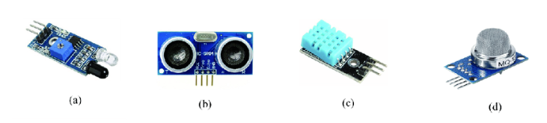
Question 5
Which of these sensors is used to measure distance?

Slide 20
Answer
B (Ultrasound)

Slide 21
5% Question

Slide 22
Question 6
What is an LED and why do we use them?

Slide 23
Answer
Light Emitting Diode
Only allow current to flow one way
Prevent catastrophic damage to system if current was to flow the wrong way

Slide 24
1% Question
1% Question

Slide 25
Question 7
What does clock speed mean and what is the clock speed on the Arduino Uno?

Slide 26
Answer
Number of computer cycles a CPU can do in a second.
16MHz

Slide 27
INRODUCTION TO ARDUINO
CI Lucas Clark
STEM

Slide 28
INTRODUCTION TO ARDUINO
Objectives
By the end of the session, you will be able to:
Describe what an Arduino is
Discuss some examples of what type of devices can be controlled and used by an Arduino board.
Describe what the different types of 'Pins' are on an Arduino board and what they do
Describe how to program to an Arduino Board.

Slide 29
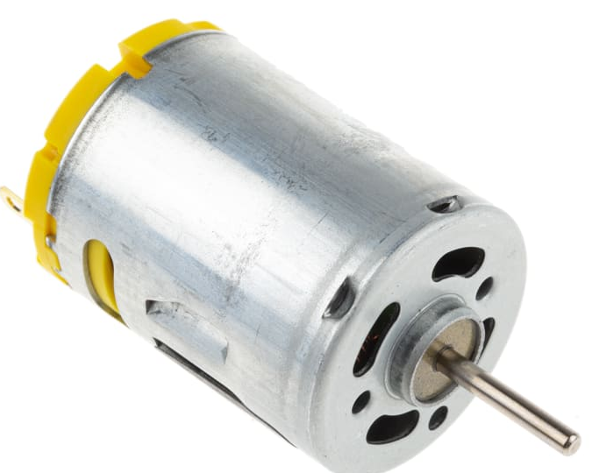
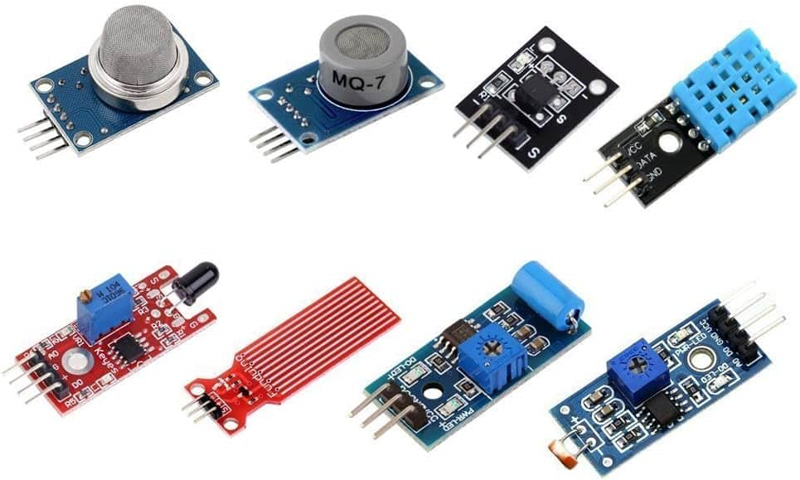

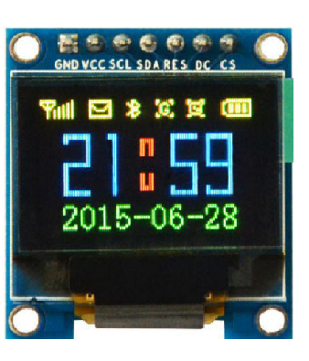
INTRODUCTION TO ARDUINO
What is an Arduino?
An Arduino board is a small computer that you can use to control electronic devices.
Like a tiny brain that can be programmed to do specific tasks and actions.
Notes:
An Arduino can be used to control and use a huge range of types of devices: motors, lights, displays, sensors and many more. Can you think of anything you might want to control to make a car?
The actual brain function of the arduino comes from the microprocessor which contains the code and logic that you code.
If you want to know more about how a microproccess works come and talk to me!

Slide 30
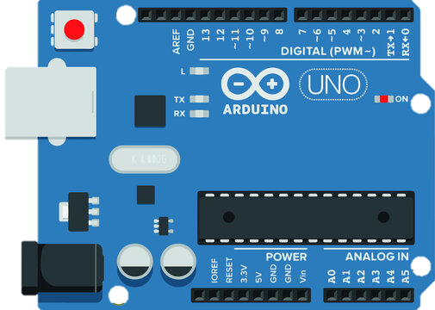
INTRODUCTION TO ARDUINO
Power
Analog
Digital
Notes:
There are 3 main types of pins on an Arduino board:
Power
Analog
Digital
Hand out the arduinos at this point.
Can you all identify where the types of pins are?

Slide 31
INTRODUCTION TO ARDUINO
How to Power the Arduino
To use the Arduino, we need to power it.
To supply power to the board there are a few ways to do it.
There is a V_{in} pin on the board.
There is a barrel jack connector.
There is the USB-B connector.
The Arduino Uno requires between 7V - 12V power supply
Notes:
Point to the powering points

Slide 32
INTRODUCTION TO ARDUINO
Power Output Pins
If you provide power to the Arduino, we can access that power to control electrical devices.
This is done using the 5v pin or the 3.3v pin
Notes:
Point to the powering points

Slide 33
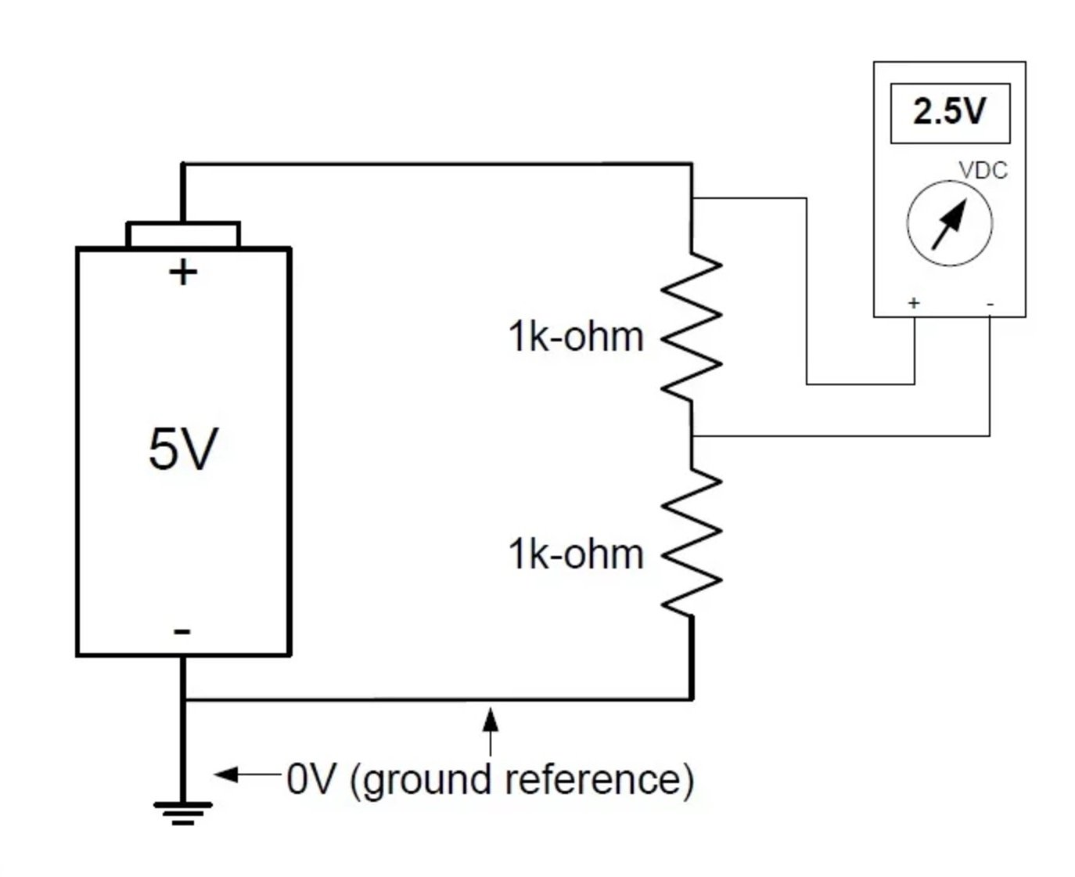
INTRODUCTION TO ARDUINO
Ground Pins (GND)
Grounding is required in all circuits just as Voltage / Power pins are
The current in a circuit travels from a power source such as a battery and travels towards the ground
This flow is what powers electrical devices

Slide 34
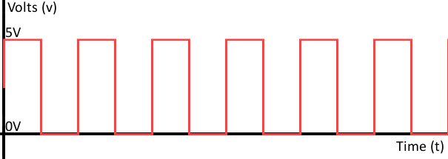
INTRODUCTION TO ARDUINO
Digital Pins
Digital signals are discrete signals. This means they can either be ON or OFF.
Notes:
Can you think of any examples of devices which may use digital signals ie: on and off?

Slide 35
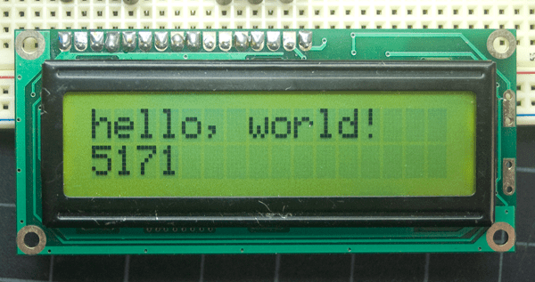
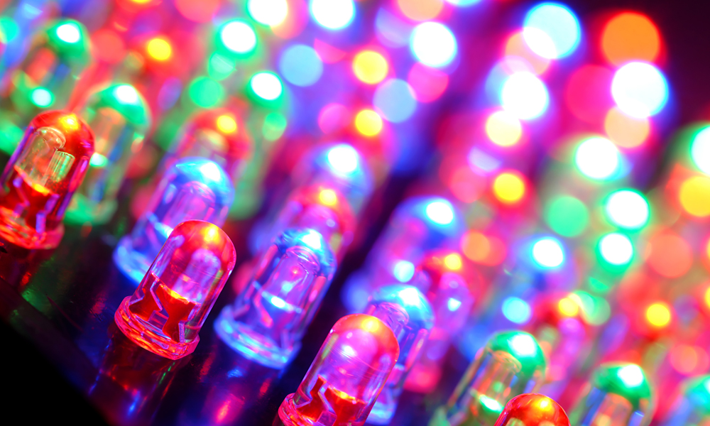
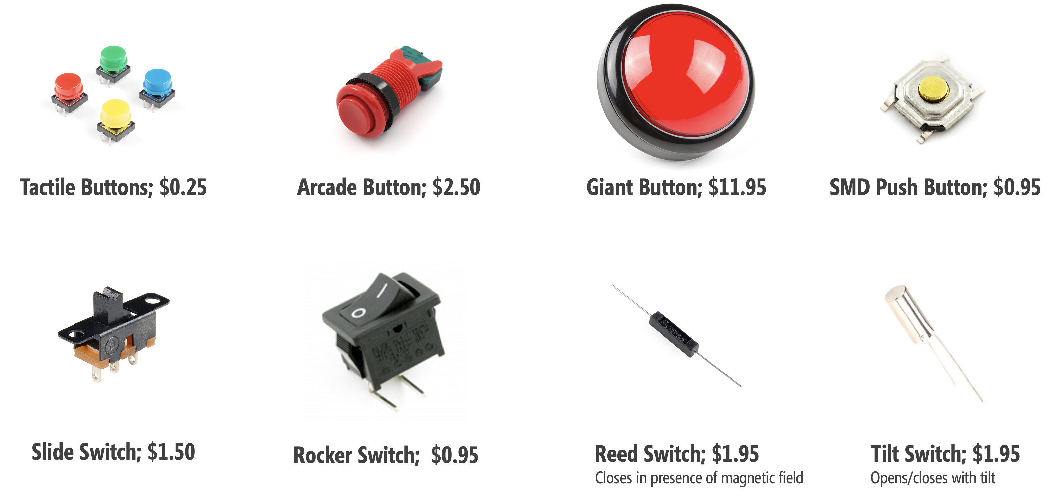
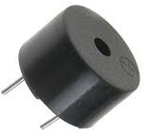
INTRODUCTION TO ARDUINO
Digital Signal Devices
Notes:
Can you think of any examples of deivces which may use digital signals ie: on and off?

Slide 36
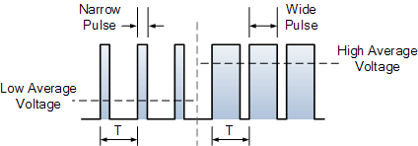
INTRODUCTION TO ARDUINO
Pulse Width Modulation (PWM) Pins
Some digital pins are PWM Pins
This means they can output signals between HIGH and LOW
This is achieved by pulsing the pin ON and OFF very quickly
Notes:
Can you think of any examples of devices which may use digital signals ie: on and off?

Slide 37
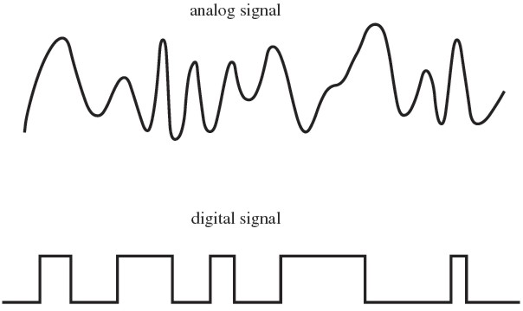
INTRODUCTION TO ARDUINO
Analog Pins
Analogue pins can read signals between 5v and 0v.
Analogue signals are great for sensors where you want very precise information.
Notes:
The Arduino's analog pins have an Analog-to-Digital Converter (ADC) that converts these analog voltages into digital values that the microcontroller can process, enabling the Arduino to read and respond to analog inputs from sensors or other devices. This allows for a wide range of applications where precise measurement and control of analog quantities are needed, such as in environmental monitoring, audio processing, and sensor-based systems.

Slide 38
INTRODUCTION TO ARDUINO
Conclusion
Now that we know what the pins of the Arduino do, how do we control them?
We program it!

Slide 39
INTRODUCTION TO ARDUINO
Any Questions?
Notes:
Get them to open up their IDEs walk through all of the points in message, make sure they all know where all of the buttons are.
Errors will be highlighted and you can use this error message to decipher what is wrong with your code.

Slide 40
INRODUCTION TO PROGRAMMING
Flt Lt Glenn Milburn
STEM
Notes:
Today we will be completing the BRONZE crest award

Slide 41
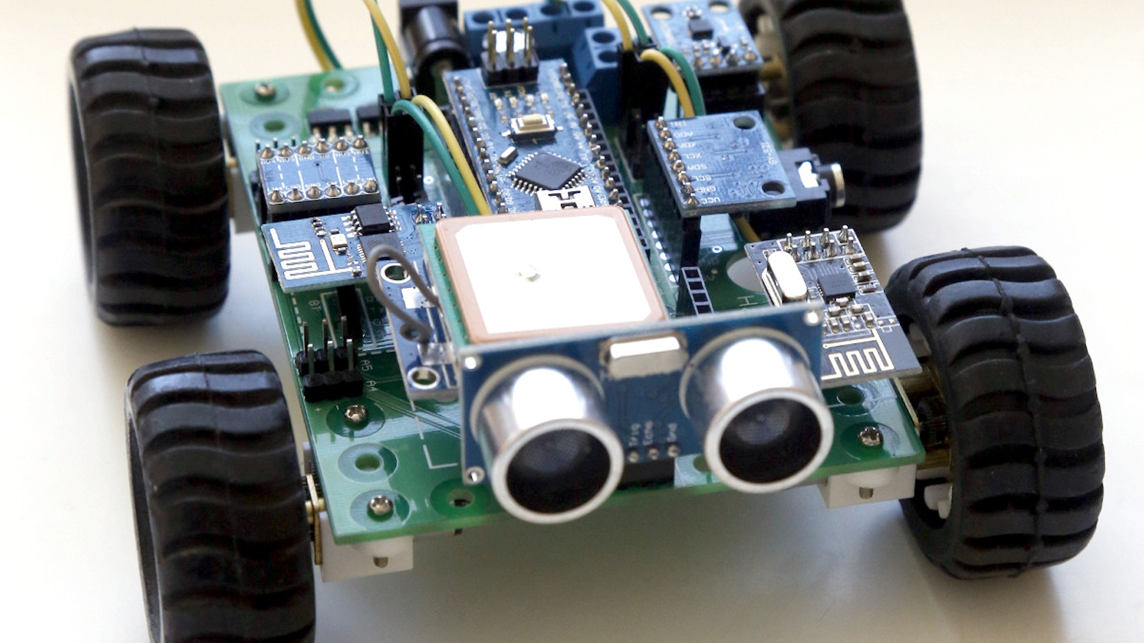
INTRODUCTION TO PROGRAMMING
Objectives
You should know:
What an Arduino is, what its components are and a basic understanding of how it will work.
What will you cover now?
How to get an output from your Arduino? What does an IDE look like and how do we write code?

Slide 42
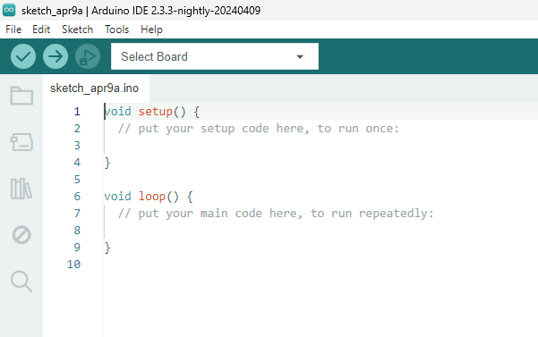
INTRODUCTION TO PROGRAMMING
Navigating the IDE
IDE stands for Integrated Development Environment
The upload button is how we transfer the code to the Arduino
This is where you select the board you are wanting to use
This is where the code you write will go

Slide 43
INTRODUCTION TO PROGRAMMING
Functions
Functions are self-contained modules of code
Setup will run when the code is initialised. It will only run once. It is used to set pin modes and start the Serial Monitor.
Loop will run infinitely once setup function has ran. Loop is where our code is going to go. It will constantly cycle through.
What does this mean?

Slide 44
INTRODUCTION TO PROGRAMMING
Functions
Program will start when after you Upload it
Start
Setup()
Setup Function executes automatically after program starts
Loop()
Loop Function starts after Setup and repeats forever
Notes:
Arduino Integrated development environment
Select board
Functions, setup and loop
Serial communications - sending data 1 bit at a time - basic communication
Tick and arrow - wipe
Line 3
Serial.begin (9600); baud rate, max poss comms /second semicolon is a complete statement, like a ‘.’
Line 8
Serial.println ("Hello World");
load - serial monitor
add delay in ms delay(500);

Slide 45
INTRODUCTION TO PROGRAMMING
Going Forward
You should now know:
How to get an output from your Arduino, What an IDE looks like and how to write code. You are now all programmers!

Slide 46
DC MOTORS
CWO Annabelle Larmour
STEM
Notes:
Brief explanation of what a DC motor does and how they are powered. Walk through powering using the 5v and GND pins, control direction by swapping pins around, reduce speed by using the 3.3v pins. Explain why a Motor Driver is needed.

Slide 47
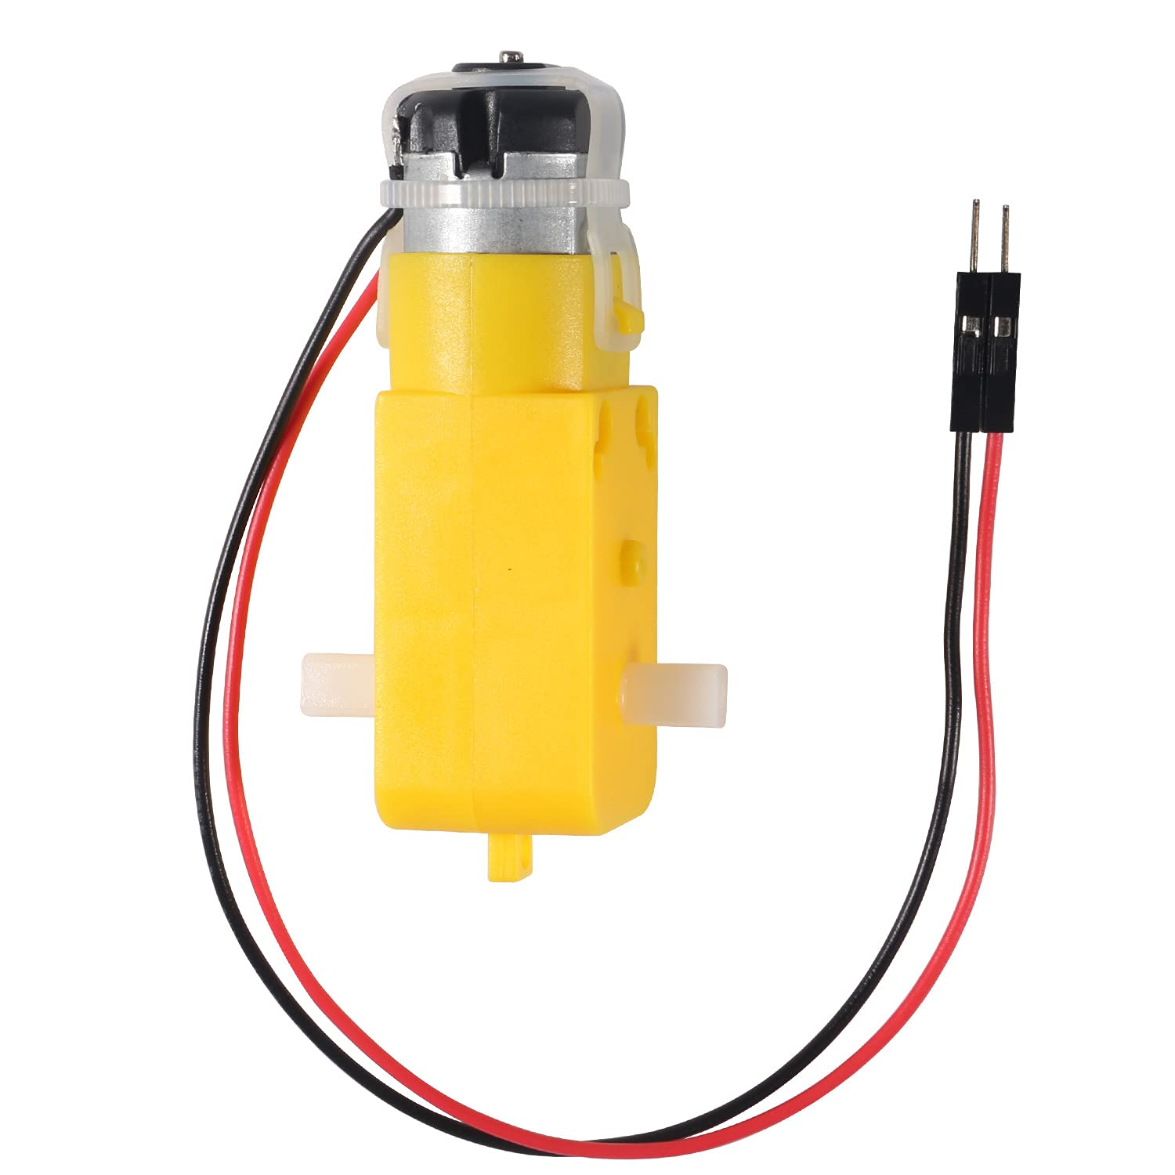
DC MOTORS
What does it look like?

Slide 48
MECHANICAL BUILD
FLT LT Glenn Milburn
SGT Kieron Sale
STEM
Notes:
How to assemble bots, cover how to read Assy drawings, BOMs, part and fixing names, balloons, exploded views, correct chassis orientation, assembly notes. Discuss why nylocs are used with washers, overtightening. Tool H&S brief.
DS to support, catch errors but allow teams to make their own, balance time impact and learning opportunity. Watch out for H&S issues.

Slide 49
ELECTRICAL BUILD
CI Lucas Clark
STEM
Notes:
How to read wiring diagram, jumper wires, Male and Female ends, screw terminals (safety tug), splicing wires. Do not plug 9V Batteries in until checked by DS.
DS to support, when teams are ready, all wiring must be checked. Incorrect wiring will lead to short circuiting.

Slide 50
MOTOR CONTROL
FG OFF Harrison Milburn
STEM
Notes:
Arduino script to send digital signals from Arduino to Motor Driver. Control each wheel individually with car on mount. Direction and speed control. Handout after teaching with code. Commenting Code. Variables. Do a straight-line race.

Slide 51
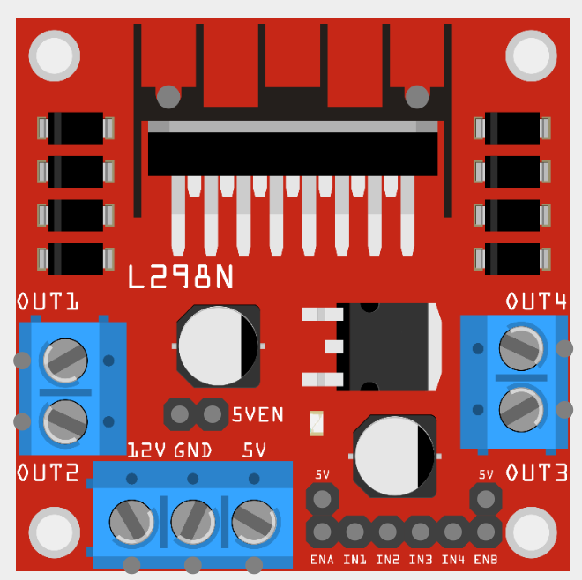
MOTOR CONTROL
L298N Motor Driver
Motor #1 Power
Motor #2 Power
Motor #1 Ground
Motor #2 Ground
Battery Ground
Battery Power
Speed and Direction Control

Slide 52
INTRODUCTION TO PROGRAMMING
L298N Motor Driver
Motor #2 Speed
Motor #1 Speed
Motor #1 Clockwise
Motor #2 Counter-Clockwise
Motor #1 Counter-Clockwise
Motor #2 Clockwise

Slide 53
ULTRASONIC SENSOR
CI Lucas Clark
CI Harry Redhead
STEM
Notes:
Fit Ultrasonic sensor (However teams want to). Guide cadets to website to learn how the ultrasonic sensor works. Write new script to print distance to the serial monitor.

Slide 54
ULTRASONIC SENSOR
Objectives
What will you learn now?
What is an ultrasonic sensor. How to deal with unknown environments. Thinking like an engineer

Slide 55
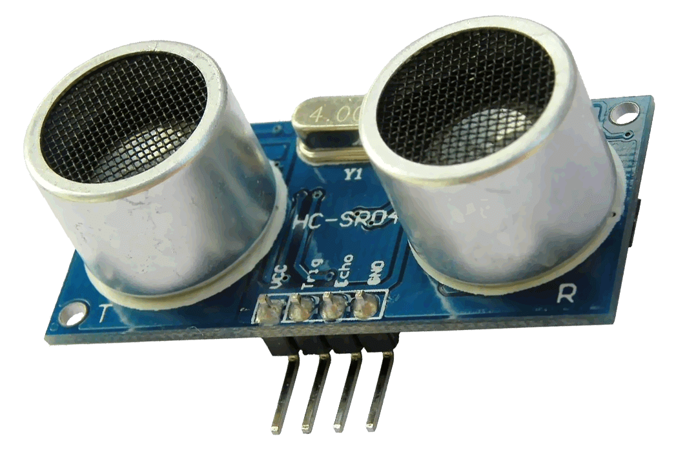
ULTRASONIC SENSOR
HC-SR04
Ultrasonic sensors are used to measure distance.
Based on this image, how do you think they do this?

Slide 56
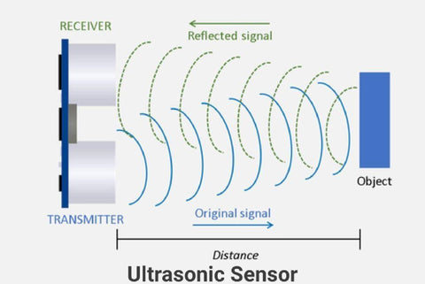
ULTRASONIC SENSOR
How it Works

Slide 57
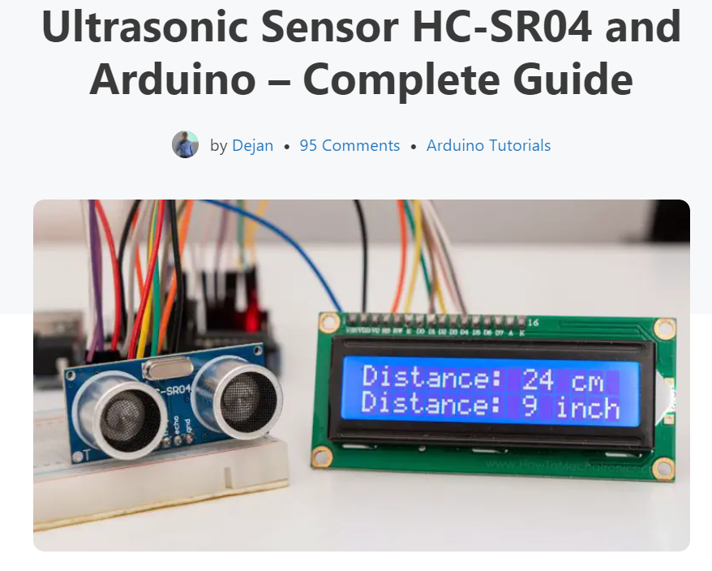
ULTRASONIC SENSOR
You Figure it Out
Now we understand how this device works, how to we implement this into our robot?
Thats for you as engineers to find out. Google "How to Mechatronics Ultrasonic sensor“
Wire in the sensor and write a new Arduino program which outputs the distance from the sensor to the Serial Monitor

Slide 58
ULTRASONIC SENSOR
Next Steps
You should now know:
What an ultrasonic sensor is, now how can we use it in our cars?

Slide 59
AUTONOMOUS CAR
FG OFF Harrison Milburn
CPL Ian Davis
STEM
Notes:
Walk through algorithm step to step for autonomous control. Code walk-through for using if else statements but leave actual code to teams. Support teams and provide help where needed.
Cadets to program their bots for autonomous control. DS to support and talk-through code to help teams get a good result. If teams do well, propose ways of making the code better.

Slide 60
AUTONOMOUS CAR
The Algorithm
Start
Is Distance Small?
Setup()
Find Distance
NO
Drive Forwards
YES
Stop
This is the loop() function!
Rotate

Slide 61
DEBREIF
STEM
Notes:
Round up on success of Autonomous control
Set expectations and goals for Day 2

Slide 62
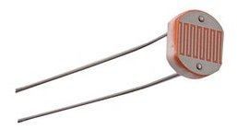
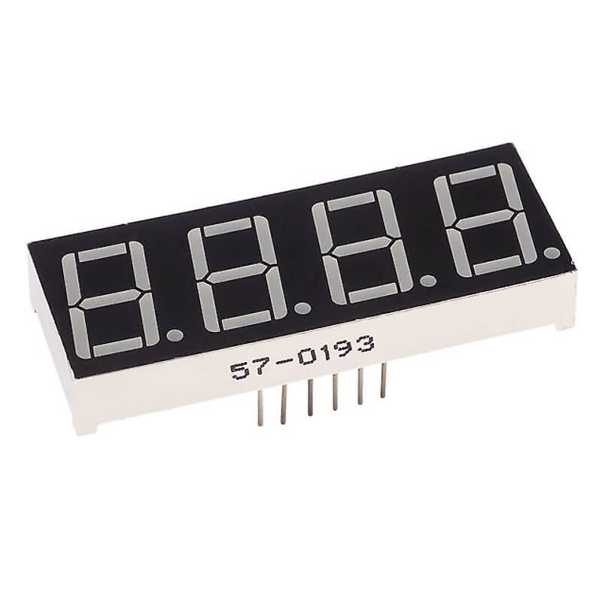
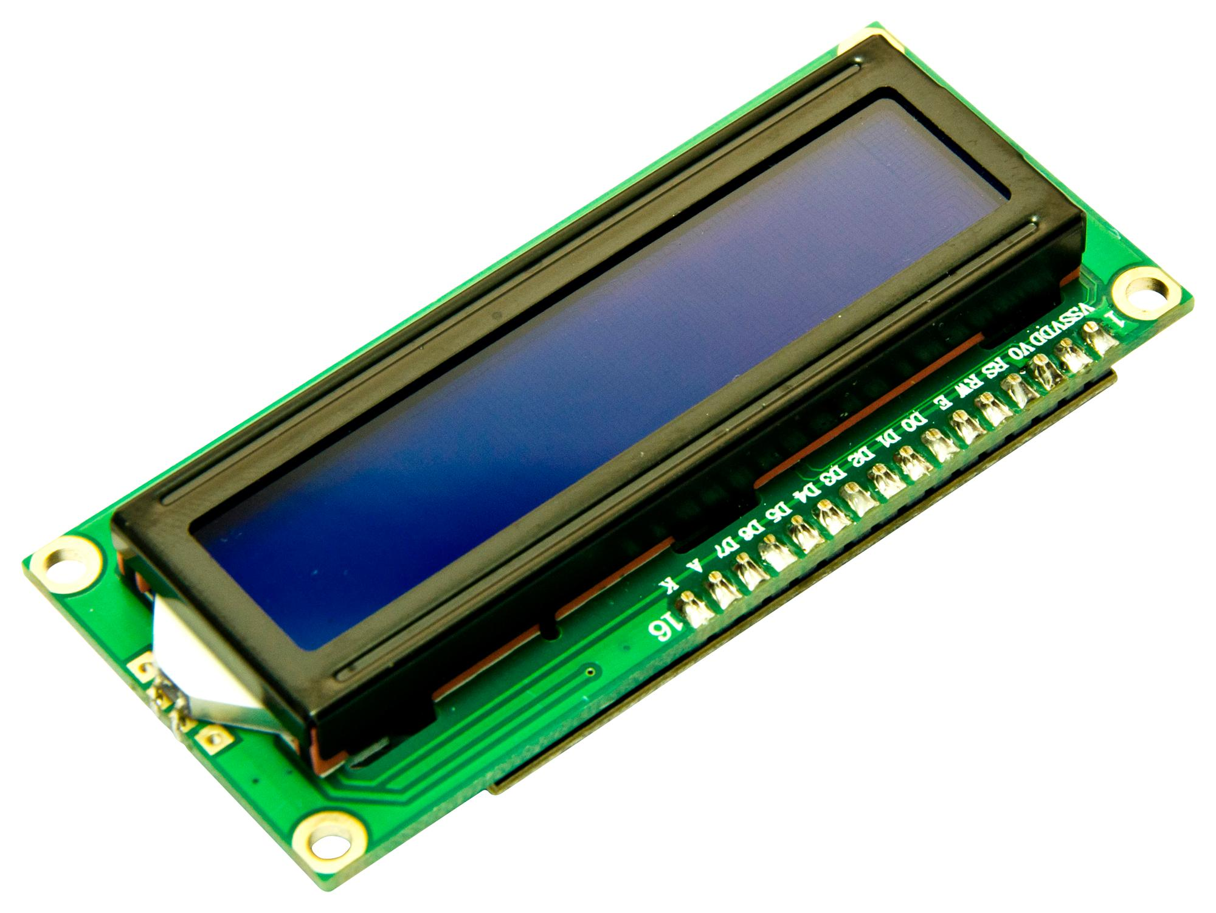
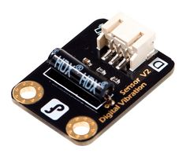
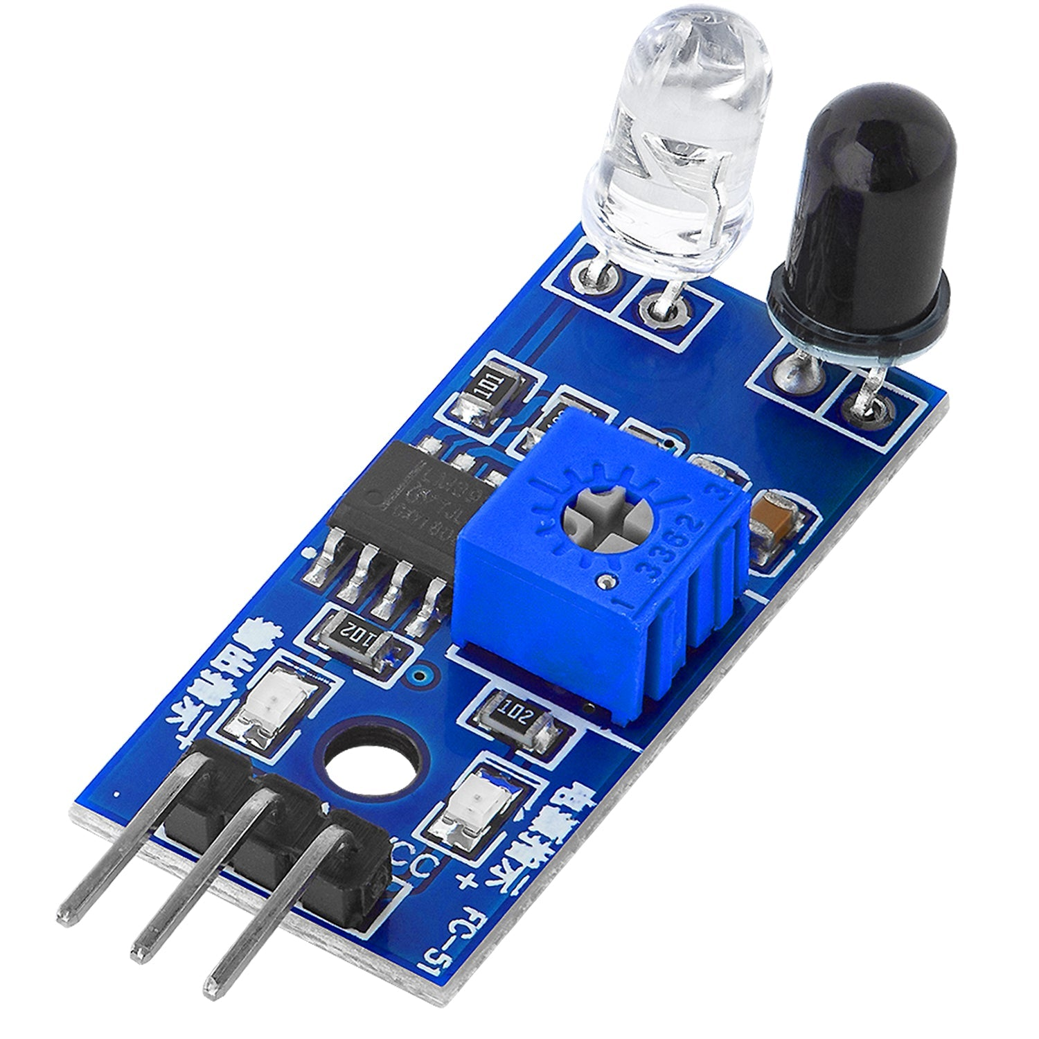
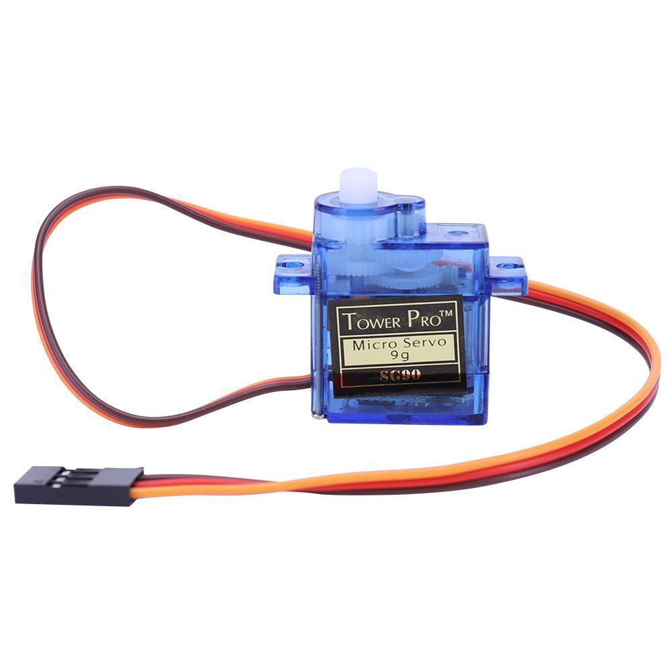
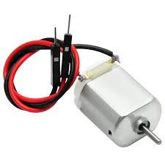
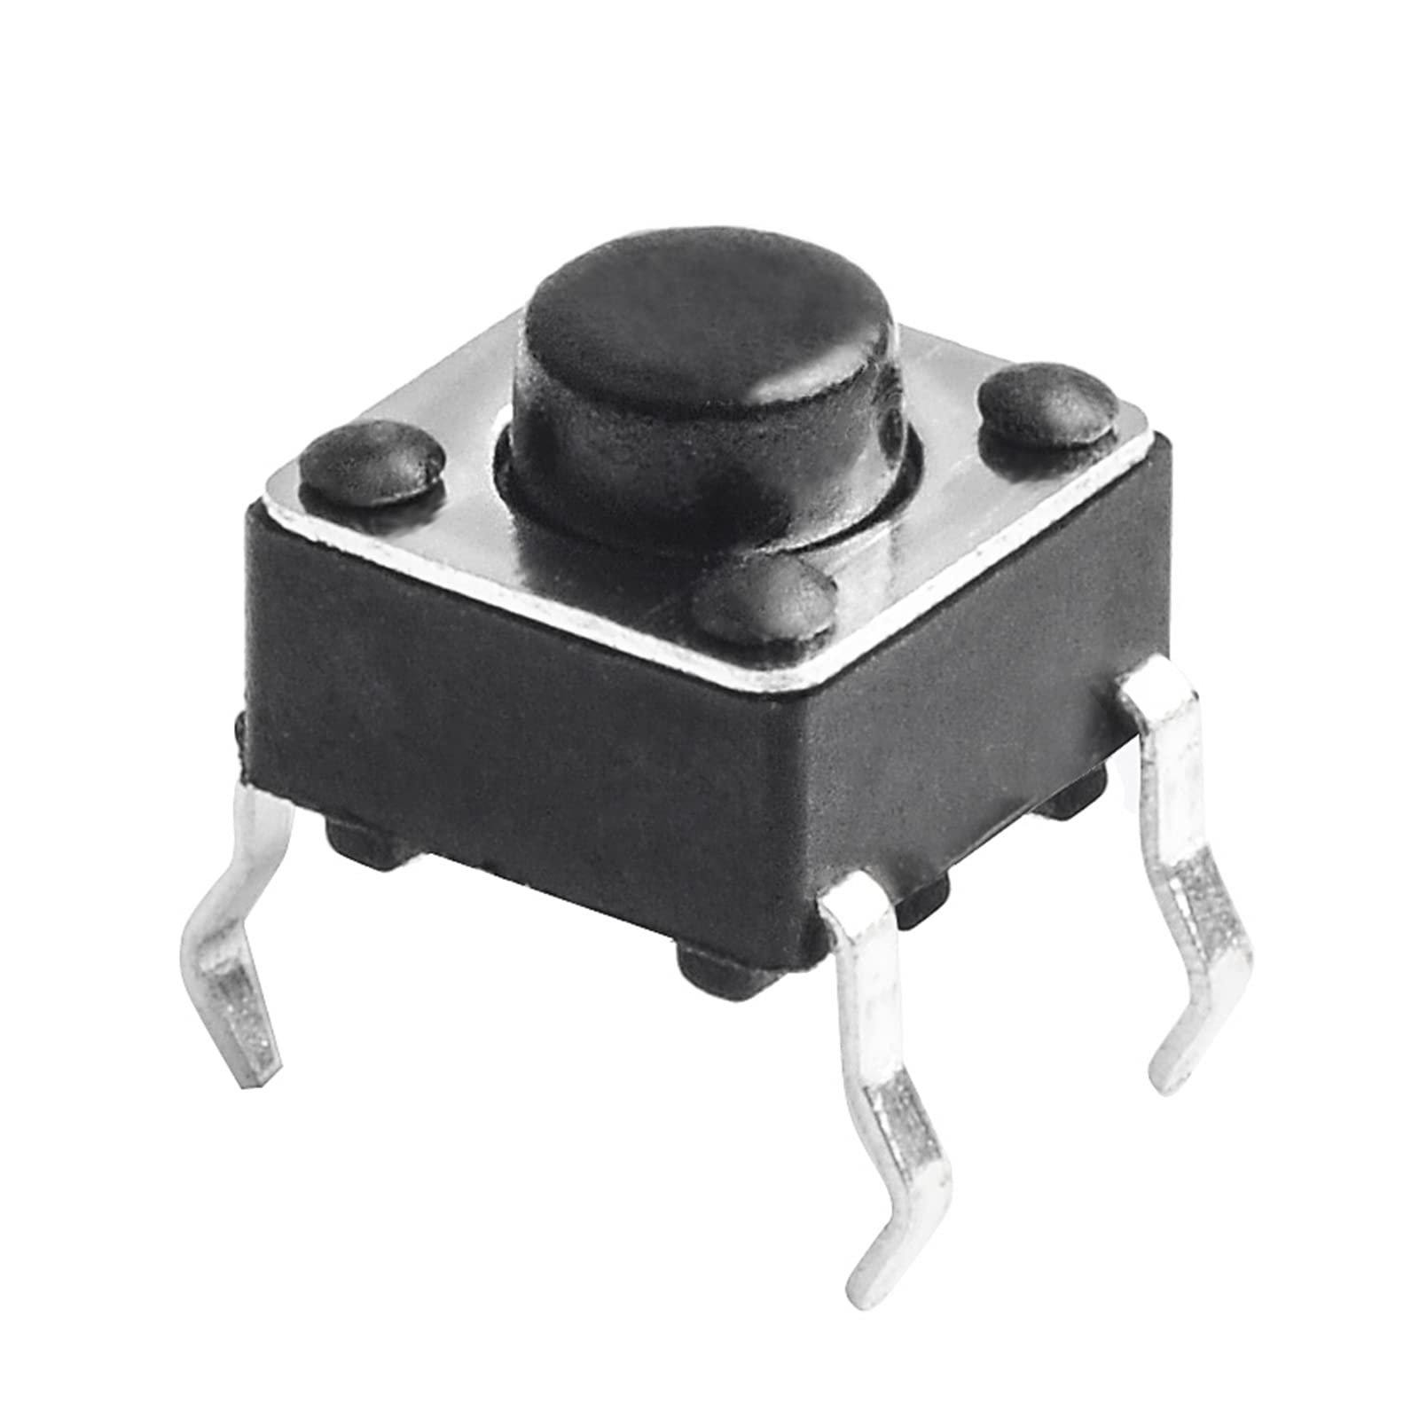
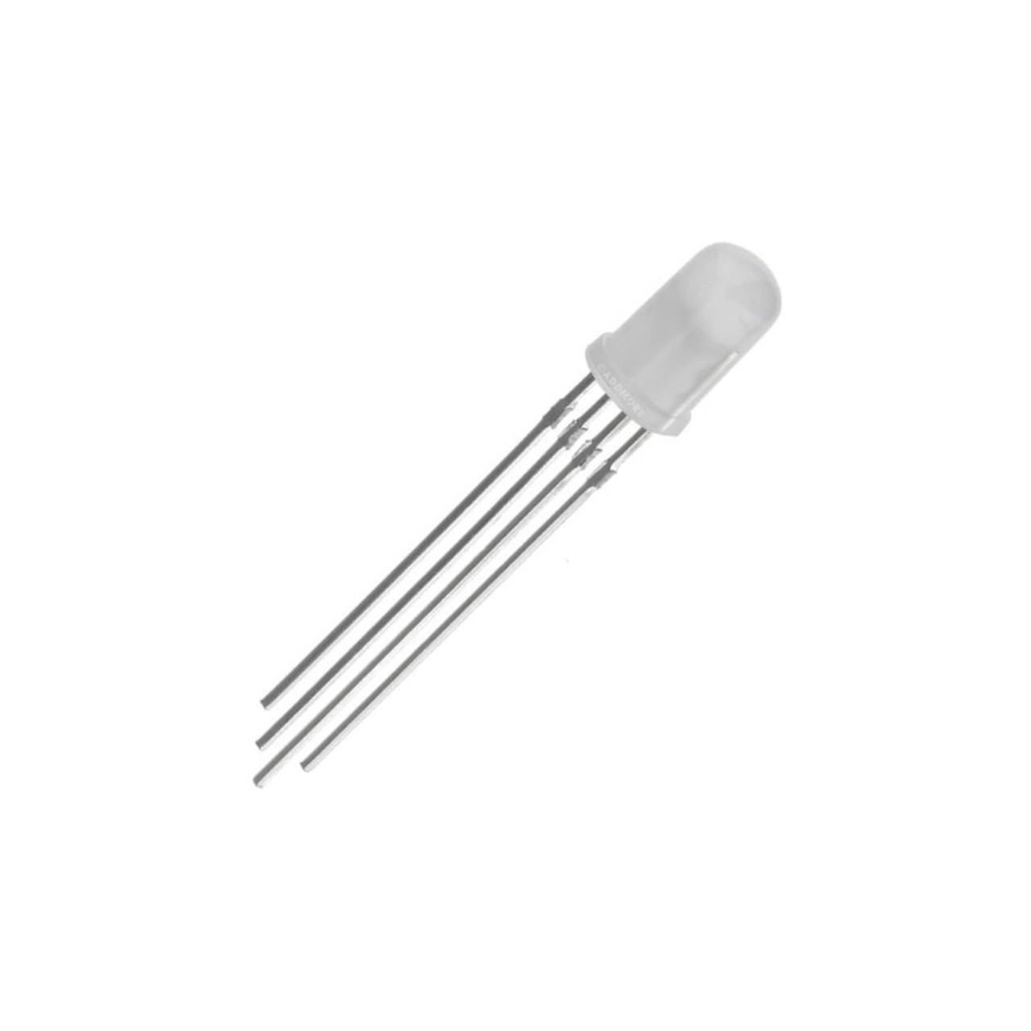
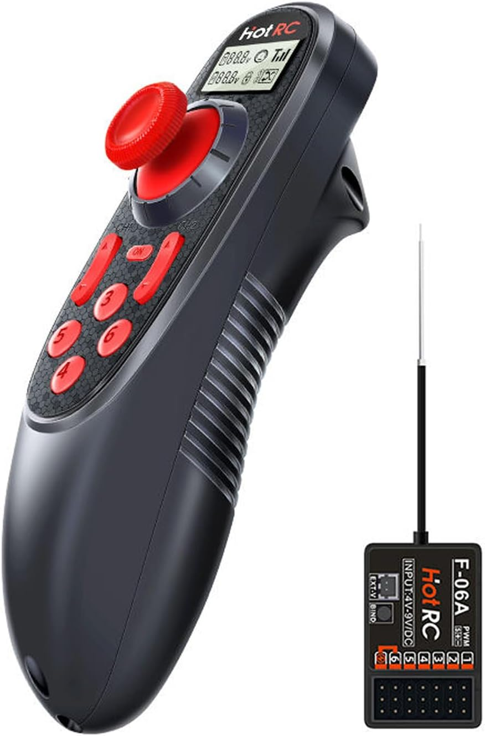
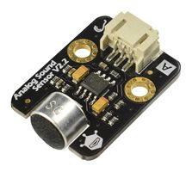
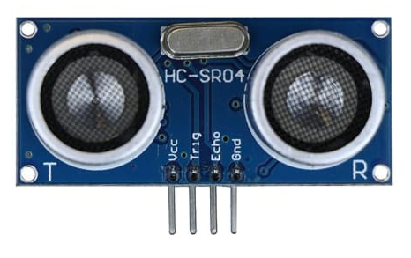
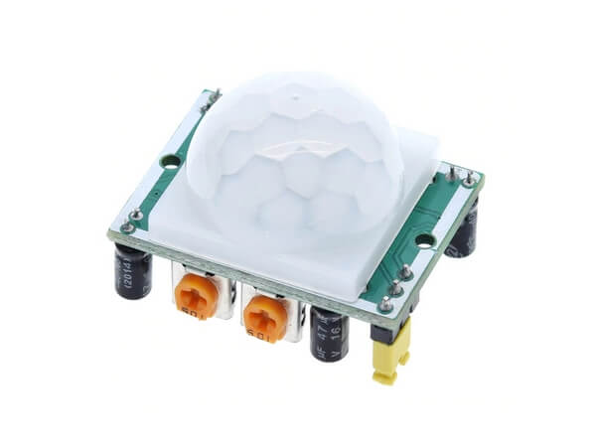
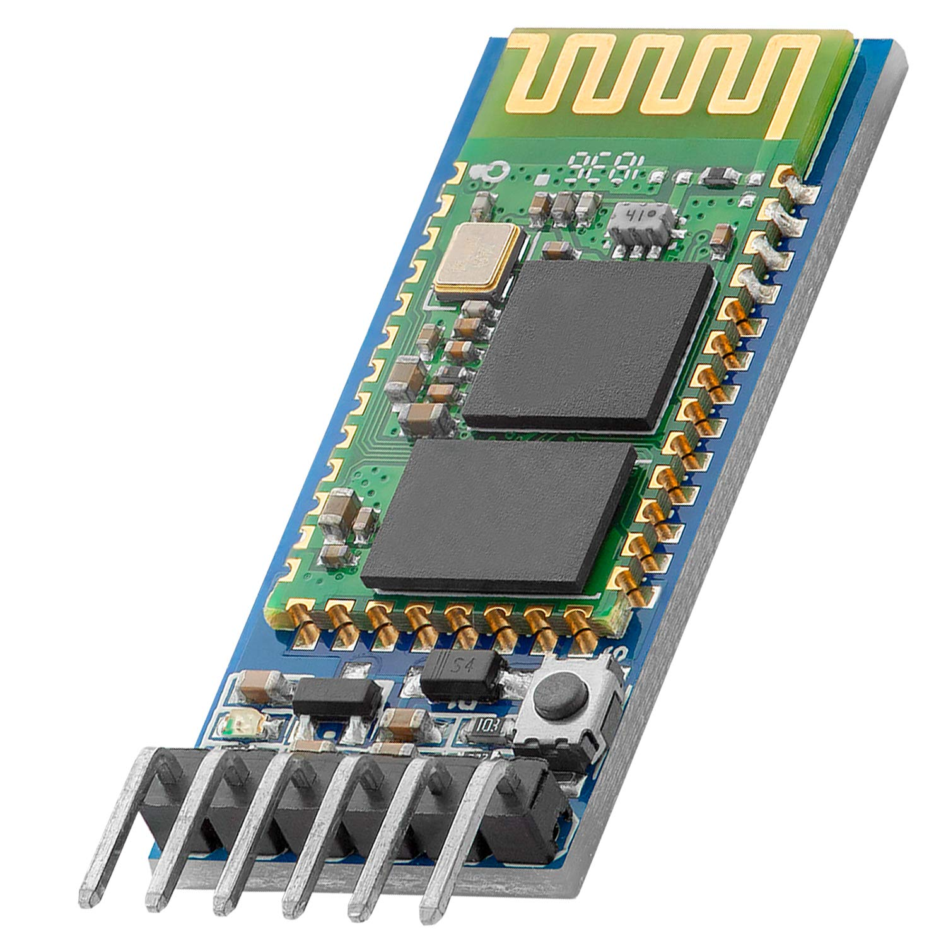
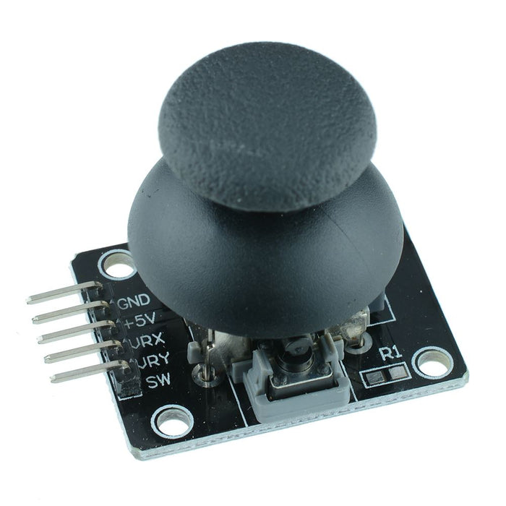
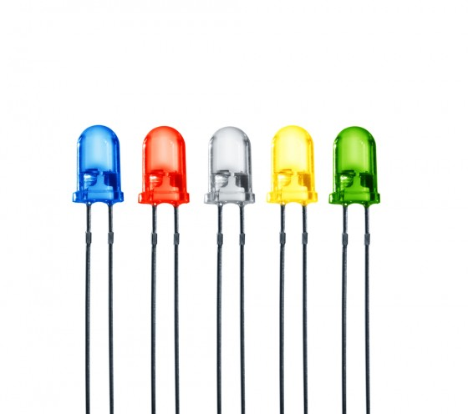
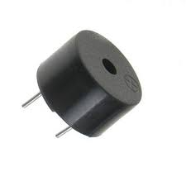
CREST PROJECTS
What we Have
Light Dependant Resistor
7-Segment Display
LCD Screen
Servo Motor
Infra-Red Sensor
Vibration Sensor
DC Motor
Pushbutton
RGB LED
Sound Sensor
Ultrasonic Sensor
Radio Controller
PIR Motion Sensor
Bluetooth Module
Piezo Buzzer
LEDs
Thumbstick
Notes:
LCD - https://howtomechatronics.com/tutorials/arduino/lcd-tutorial/
Servo - https://docs.arduino.cc/tutorials/generic/basic-servo-control/ Ultrasonic Sensor - https://howtomechatronics.com/tutorials/arduino/ultrasonic-sensor-hc-sr04/ Light Dependant Resistor - https://www.circuitbasics.com/how-to-use-photoresistors-to-detect-light-on-an-arduino/
RGB LED – (common cathode) https://www.build-electronic-circuits.com/arduino-rgb-led/#:~:text=If%20you're%20using%20a%20common%20cathode%20RGB%20LED%2C%20connect,through%20a%20220%2Dohm%20resistor. Bluetooth Module - https://howtomechatronics.com/tutorials/arduino/arduino-and-hc-05-bluetooth-module-tutorial/ Pushbutton - https://www.instructables.com/How-to-use-a-Push-Button-Arduino-Tutorial/ LED - https://roboticsbackend.com/arduino-led-complete-tutorial/ Piezo Buzzer - https://www.instructables.com/How-to-use-a-Buzzer-Arduino-Tutorial/ Potentiometer - https://docs.arduino.cc/tutorials/uno-rev3/AnalogReadSerial/ Infra-Red Sensor - https://circuitdigest.com/microcontroller-projects/interfacing-ir-sensor-module-with-Arduino Thumbstick - https://arduinogetstarted.com/tutorials/arduino-joystick

Slide 63
ROBOTICS COURSE – AUTONOMOUS CAR PROJECT
STEM

Slide 64
CREST AWARDS
…
STEM
Notes:
Describe what CREST Awards are and why they’re important, that they’re cadet led, requires a workbook to be filled in.

Slide 65

CREST AWARDS
What is a CREST Award?
Designed to get YOU to think like scientists and engineers
CREST is a Nationally recognised award great for College, University and Job applications

Slide 66

CREST AWARDS
Levels of Award

Slide 67
CREST AWARDS
Levels of Award
BRONZE
10 HOURS
£5
5 PARADE NIGHTS
OR
1 FULL WEEKEND
COMPLEX PROJECT
BEST FOR 14-16 YEAR OLDS

Slide 68
CREST AWARDS
How They Work
Cadets Choose Project
Research Project
Plan Project
Execute Plan
Consolidate Results
Present Findings
Complete CREST Workbook Throughout

Slide 69

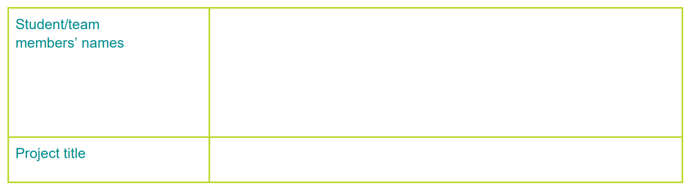




CREST AWARDS
BRONZE PASS CRITERIA
PLANNING
PROJECT
CONSOLIDATION
PROJECT-WIDE
1.1 Clear Project Aim
2.1 Good Use of Resources
3.1 Project Conclusions
4.1 Scientific Understanding
1.2 Project Purpose
2.2 Research and Referencing
3.2 Personal Contribution
4.2 Safety Considerations
1.3 Multiple Approaches
3.3 Project Reflection
4.3 Creative Thinking
1.4 Had a Project Plan
4.4 Problem Solving
1.5 Time Management
4.5 Project Presentation
Notes:
To pass the course you must complete / meet 11 of the 15 criteria, these are written within your booklets.

Slide 70
CREST PROJECTS
FG OFF Harrison Milburn
STEM
Notes:
Describe the options for teams to select from, talk them through and offer possible paths to success for each, allow teams to select based on ability level.

Slide 71
CREST PROJECTS
What we Have
Light Dependant Resistor
7-Segment Display
LCD Screen
Servo Motor
Infra-Red Sensor
Vibration Sensor
DC Motor
Pushbutton
RGB LED
Sound Sensor
Ultrasonic Sensor
Radio Controller
PIR Motion Sensor
Bluetooth Module
Piezo Buzzer
LEDs
Thumbstick
Notes:
LCD - https://howtomechatronics.com/tutorials/arduino/lcd-tutorial/
Servo - https://docs.arduino.cc/tutorials/generic/basic-servo-control/ Ultrasonic Sensor - https://howtomechatronics.com/tutorials/arduino/ultrasonic-sensor-hc-sr04/ Light Dependant Resistor - https://www.circuitbasics.com/how-to-use-photoresistors-to-detect-light-on-an-arduino/
RGB LED – (common cathode) https://www.build-electronic-circuits.com/arduino-rgb-led/#:~:text=If%20you're%20using%20a%20common%20cathode%20RGB%20LED%2C%20connect,through%20a%20220%2Dohm%20resistor. Bluetooth Module - https://howtomechatronics.com/tutorials/arduino/arduino-and-hc-05-bluetooth-module-tutorial/ Pushbutton - https://www.instructables.com/How-to-use-a-Push-Button-Arduino-Tutorial/ LED - https://roboticsbackend.com/arduino-led-complete-tutorial/ Piezo Buzzer - https://www.instructables.com/How-to-use-a-Buzzer-Arduino-Tutorial/ Potentiometer - https://docs.arduino.cc/tutorials/uno-rev3/AnalogReadSerial/ Infra-Red Sensor - https://circuitdigest.com/microcontroller-projects/interfacing-ir-sensor-module-with-Arduino Thumbstick - https://arduinogetstarted.com/tutorials/arduino-joystick

Slide 72
INRODUCTION TO PROJECT MANAGEMENT
FLT LT Glenn Milburn
STEM
Notes:
Today we will be completing the BRONZE crest award

Slide 73
CREST AWARDS
What will we cover?
You should know:
What CREST Awards are and an idea of what your project goal is going to be.
What will you cover now?
How to plan a project? What is Project flexibility and how to measure success?

Slide 74

CREST AWARDS
Planning the Project
What is a Project?
Individual or Team enterprise planned to achieve a particular aim
Why do Projects fail?
Poor planning
Unclear responsibilities
Inflexibility

Slide 75
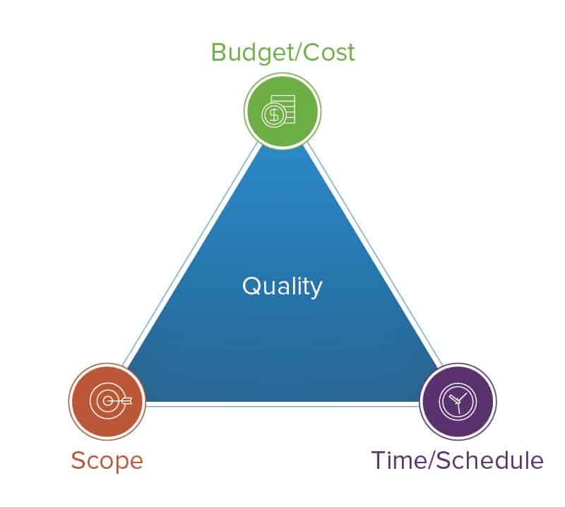
CREST AWARDS
Planning the Project
Resources
Team Agreement
Scope
Responsibilities
Metrics
Contingencies
Outcome
Scope
Schedule
Notes:
Iron triangle of the project, cannot change one without affecting others

Slide 76
CREST AWARDS
Scope
What do you want to achieve?
Make it challenging
How could you stretch to make it better?
How can you ‘dial back’ if it appears unachievable?
Method used to implement progress
Iterative or Incremental?

Slide 77
CREST AWARDS
Ideology
Iterative Model
Research
Plan
Basic plan
Make Better
Test
Implement
Notes:
Entire plan, get the basics working, when happy, move on to more complexity

Slide 78
CREST AWARDS
Ideology
Incremental (Waterfall) Model
Entire Plan
Research
Design
Implement
Test
Deploy
Notes:
Whole plan complete entire sections before moving on to the next level

Slide 79

CREST AWARDS
Responsibilities
Who is doing what?
Identify Abilities
Assign Roles
Use known strengths
Stick to your role, but assist if required

Slide 80
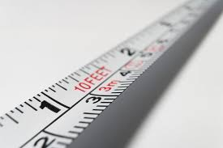
CREST AWARDS
Metrics
Success Criteria?
Have you met the Initial Plan
Does it work as expected
Is it predictable

Slide 81
CREST AWARDS
Contingencies
Running out of Time?
Don’t let ‘Perfect’ be the Enemy of ‘Good’
Attempts at perfection can jeopardise the project
Focus on outcomes, not perfection
Not going to Plan?
Adjust the Project Plan as necessary – be flexible
Dial-back ambitions to ensure success
Beware of ‘Scope Creep’

Slide 82
CREST AWARDS
Going forward
You should now know:
How to plan and deliver a project
How to amend a plan to achieve delivery
How to measure success
Well done. You are all now Project Managers

Slide 83
AUTONOMOUS CAR
Flowcharts
Start
Is Distance Small?
Setup()
Find Distance
NO
Drive Forwards
YES
Stop
Rotate

Slide 84
PROJECT WORK
STEM

Slide 85
TEAM PRESENTATIONS
STEM

Slide 86
CREST AWARDS
Team Presentations
Your presentation should include:
Who you are, What your project is
Project Aims and Objectives
What you researched
How you worked on your project
Who did what
Overall results
Demonstration
Project Reflection

Slide 87
